Slide 1

WELCOME TO MY PRESENTATION
NAME: S. M. Rafi Alam
ID: 17201053
Sec: A(2)

Slide 2


Agriculture & Technology Management System

Slide 3
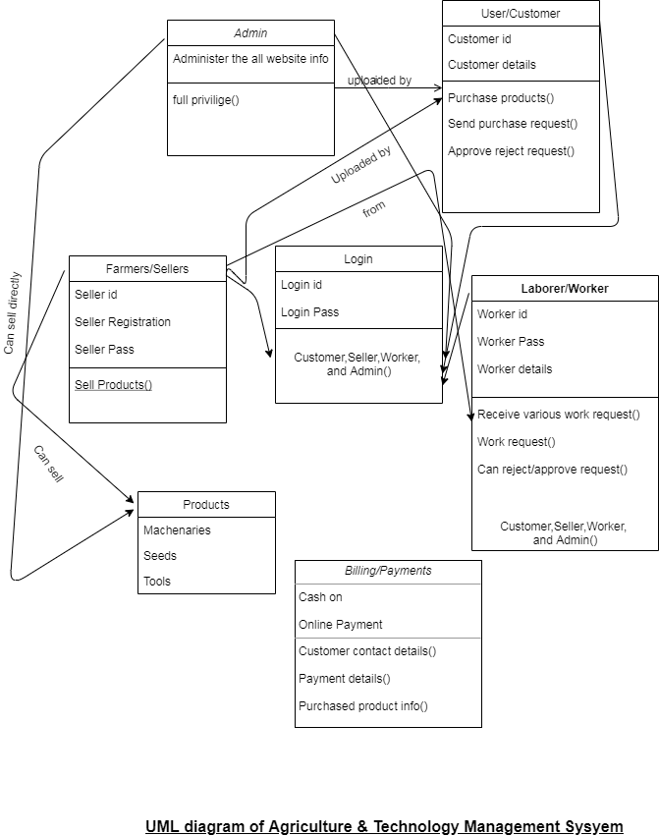

Slide 4
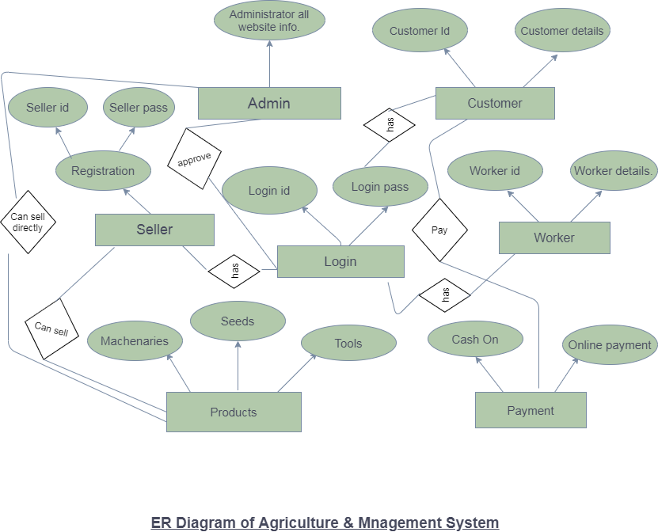

Slide 5
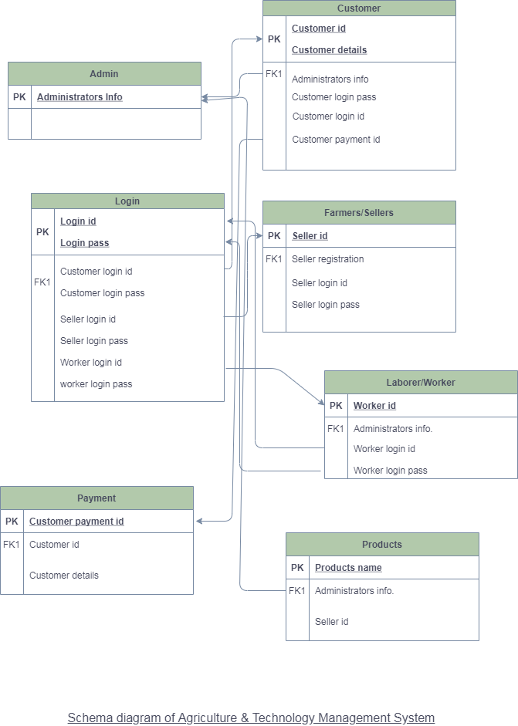

Slide 6
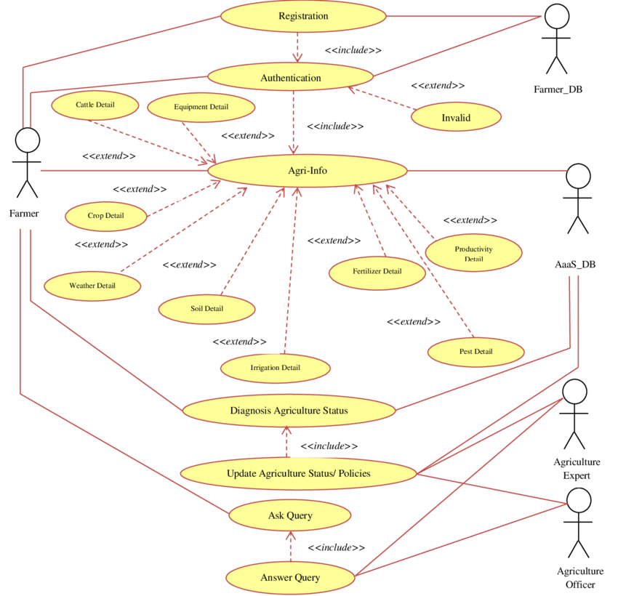
Use Case diagram:

Slide 7
THANK YOU ☺

